Slide 1

Analysis of Airbnb Rentals in NYC
2
+
2
+
Ryan Chung

Slide 2
Agenda
Business Problem
Data
Methods
Results
Conclusion

Slide 3
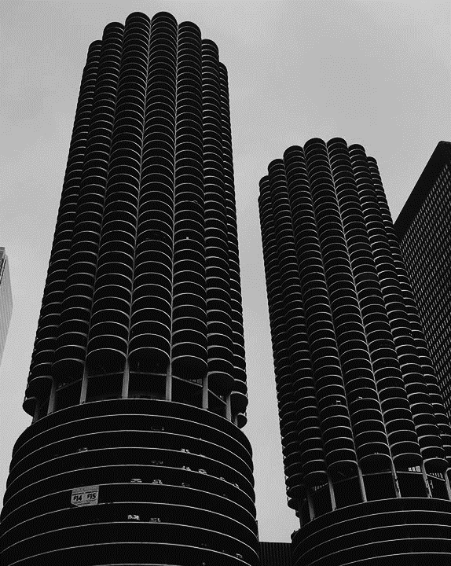
Business Problem
2
+
A real estate agency is looking to discover which model would be best for predicting the selling price of an Airbnb rental in NYC from a provided data set. The agency is looking to then use the base model in order to improve their ability to determine what the selling point of their own rentals should look like in the area.

Slide 4
Data
For this project the data set that was provided by the real estate agency is one found on Kaggle. It contains information on Airbnb rentals for the year of 2019 for NYC. Several features of rentals are included such as a rentals neighborhood and review count.

Slide 5
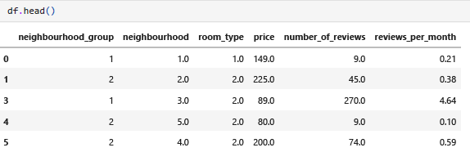
Data After Clean

Slide 6

Methods
2
+
For this project, multiple models were used to analyze the data provided. First a multiple linear regression model was created. Second, a KNN model was created. Third, a Decision Tree model was created. Fourth, a Random Forest model was created. Fifth, a XGBoost Regressor model was created. Lastly, a deep neural network was used as well.
To evaluate each model, the R squared, MAE, MSE, and RMSE were obtained for each one. The metric used to compare one model to another was the MSE.

Slide 7
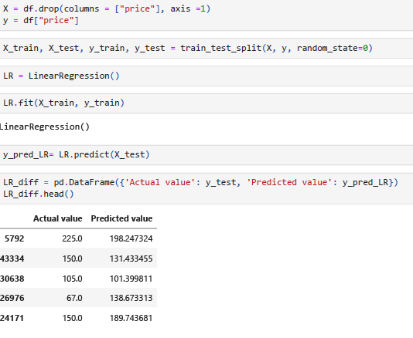
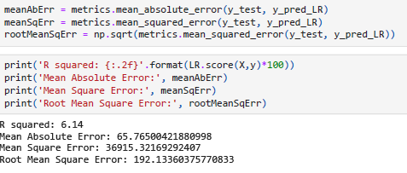
MLR
Multiple Linear Regression

Slide 8
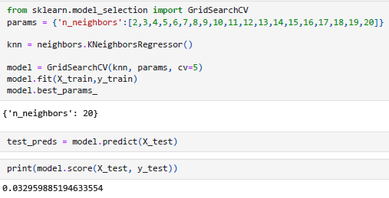
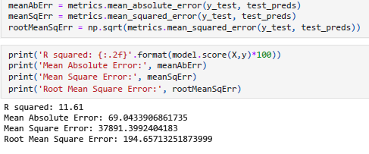
KNN
K Nearest Neighbor

Slide 9
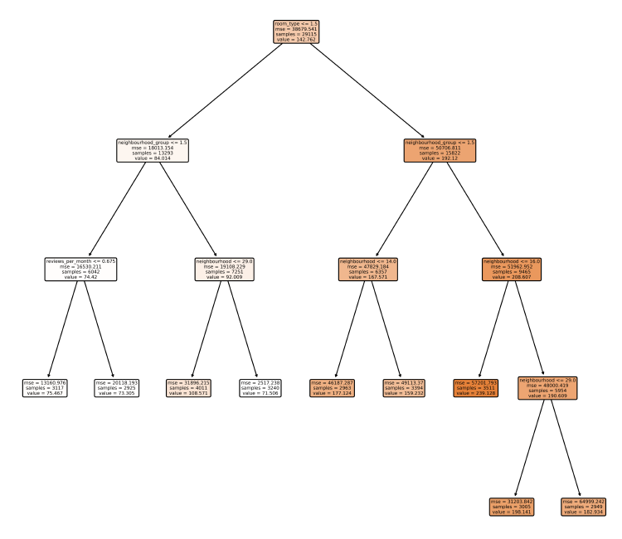
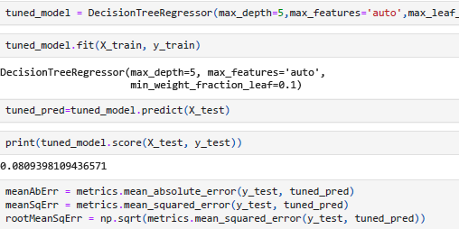
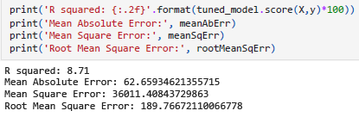
DTR
Decision Tree Regressor

Slide 10
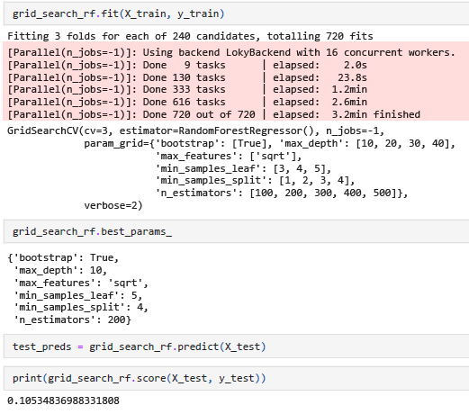
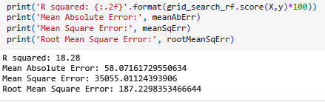
RFR
Random Forest Regressor

Slide 11
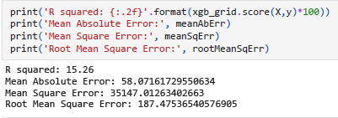
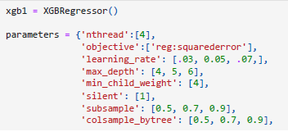
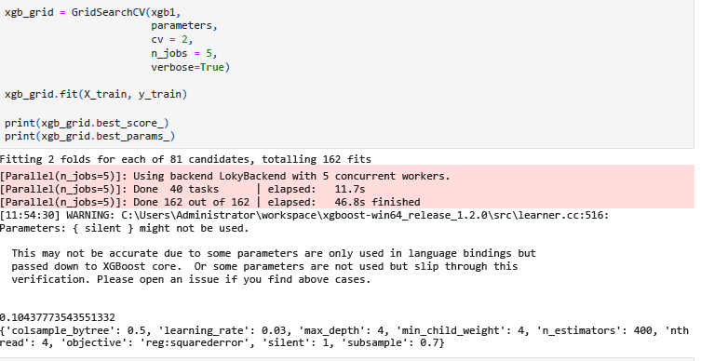
XGBoost
XGBoost Regressor

Slide 12
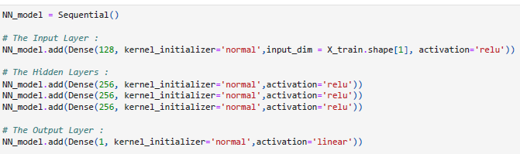

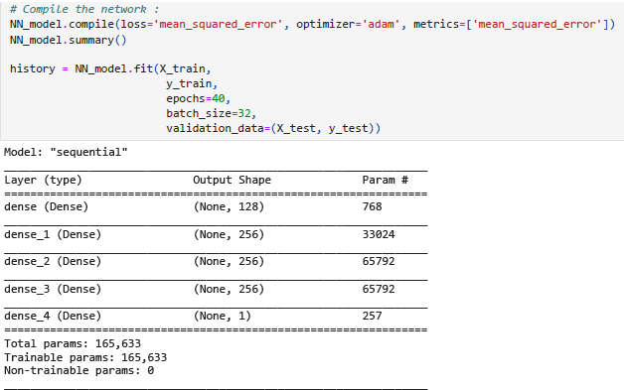
NN
Deep Neural Network

Slide 13
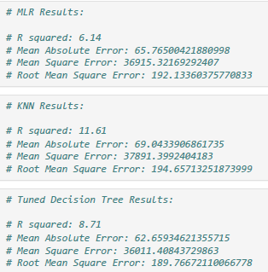
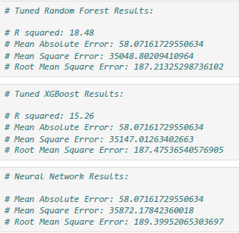
Results
Taking a look at the results to the right, we can see that the model with the lowest Mean Squared Error was the tuned Random Forest Regressor. (MSE of 35048).
The model with the second lowest Mean Squared Error was the XGBoost Regressor. (MSE of 35147).

Slide 14
Conclusion
For this project, we were able to confirm the Random Forest Regressor Model had the lowest Mean Squared Error compared to the other models created.
Given the nature of the data set provided it is recommended to further develop each model.

Slide 15
THANK YOU
2
+
2
+

